Slide 1
PREDICTING LEVELS OF DAMAGES TO BUILDINGS CAUSED BY EARTHQUAKE
Presented by,
ARULSELVAM M
GOWTHAM R
PRANAV VARSHAN A T
RAJADURAI P
Project Guide
Dr. R. RAGUPATHY

Slide 2
Abstract
The 2015 Nepal earthquake, a catastrophic 7.8 magnitude event, caused severe infrastructure damage and a tragic loss of life. This disaster underscored the urgent need for improved disaster management and preparedness. Predicting building damage levels post-earthquake is critical for effective response and resource allocation during such crises. This project utilizes deep learning models to predict damage levels to buildings using features such as structural details, building materials, and geographical information. By analyzing data from the 2015 Nepal earthquake, the project aims to understand patterns in building vulnerability. The insights generated will help authorities prioritize rescue operations and allocate resources efficiently. Additionally, the findings can guide urban planning to minimize risks in earthquake-prone areas. This work enhances disaster resilience and preparedness, ensuring safer communities and improving disaster response strategies for future seismic events.

Slide 3
Objectives
Develop a robust and accurate predictive model for classifying building damage levels caused by earthquakes using advanced deep learning techniques.
Damage Assessment: Accurately estimate the extent of potential building damage following seismic events.
Model Comparison: Evaluate and compare the performance of various deep learning models, including CNNs, LSTMs, and Transformers, on structured tabular data.
Disaster Readiness: Improve disaster preparedness and risk management by offering actionable insights into infrastructure vulnerability.

Slide 4
Problem Statement
Predicting structural damage levels (low, medium, high) to buildings during earthquakes is critical for timely disaster response but challenging due to accessibility issues and data complexity. Traditional ML models struggle with high-dimensional, imbalanced datasets and often miss complex feature interactions. This project aims to build a scalable AI system using deep learning and transformer-based models to improve classification accuracy, especially for underrepresented severe damage cases.

Slide 5
Significance of the Study
Benefits for Disaster Management
Rapid Response: Enables emergency services to identify high-risk zones and allocate resources more effectively.
Early Warning Systems: Integrates with real-time data feeds to provide anticipatory insights before full-scale damage occurs.
Post-Event Analysis: Assists in evaluating the effectiveness of existing infrastructure and response strategies after earthquakes.

Slide 6
Usefulness for Infrastructure Planning and Policy
Risk-Aware Urban Planning: Supports the development of zoning laws and construction codes based on predicted damage risk.
Policy Formulation: Provides evidence-based insights to inform disaster mitigation policies at regional and national levels.
Investment Prioritization: Helps identify critical areas requiring retrofitting or reconstruction investments to improve resilience.

Slide 7
Literature Review - Overview
Evolution from Traditional Models to AI/ML
Early approaches relied on empirical formulas, engineering judgment, and seismic codes for estimating damage.
These methods lacked adaptability to varied structural types and local conditions.
With increasing data availability, AI and ML models began replacing rigid formulas with data-driven predictions.
Deep learning models emerged as powerful tools for capturing complex, nonlinear relationships in high-dimensional data.

Slide 8
General Trends in Previous Research
Shift from hand-crafted features to automated feature learning.
Use of structured datasets (e.g., building materials, location, height) to train classification models.
Growing interest in comparing traditional ML vs DL approaches.
Focus on increasing model accuracy, scalability, and generalization.

Slide 9
Literature Review – Machine Learning Approaches
Common ML Models Used
Random Forest (RF): Popular due to robustness and interpretability.
Support Vector Machines (SVM): Effect for high-dimensional classification.
Gradient Boosting Machines (XGBoost, LightGBM): Known for strong performance on tabular data.
K-Nearest Neighbore (kNN) and Logistic Regression used in early-stage studies.

Slide 10
Limitations of ML Approaches
Struggle with learning temporal or hierarchical patterns.
Require extensive feature engineering.
Often overfit small or imbalanced datasets.
Performance can plateau compared to deep learning models on complex tasks.

Slide 11
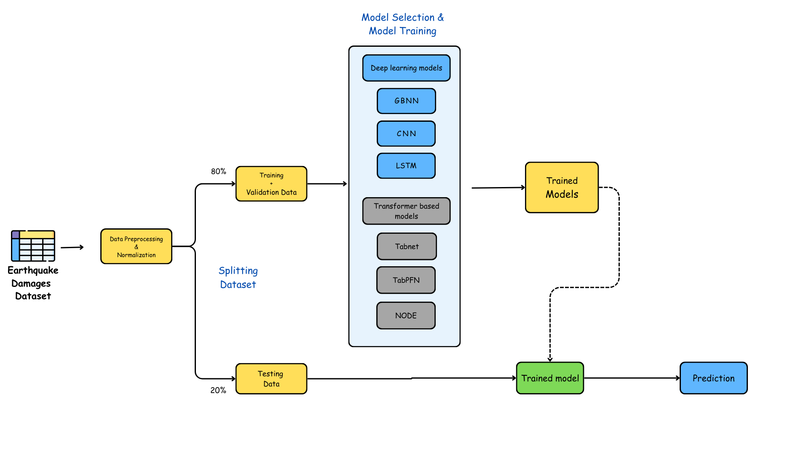
Methodology – Overview

Slide 12
Data Collection
Real-world dataset comprising structural, locational, and geotechnical features of buildings affected by past earthquakes.
Includes categorical and numerical variables relevant to damage assessment.

Slide 13
Dataset Description
The dataset used in this project is the "2015 Nepal Earthquake Building Damage Assessment" dataset, which is publicly accessible on Kaggle. It contains detailed records of over 25,000 buildings affected by the Gorkha Earthquake. This rich dataset includes a mix of structural, geospatial, and demographic attributes that serve as predictors for the damage classification task. It is considered a real-world benchmark for disaster impact modeling.

Slide 14
Key Attributes:
Structural Features: count_floors_pre_eq, age, area_percentage, height_percentage — These represent the core physical parameters of buildings.
Geospatial Features: latitude, longitude, district_id — Help in associating seismic impact based on location.
Categorical Features: land_surface_condition, foundation_type, roof_type, ground_floor_type — Represent categorical infrastructure elements.
Target Variable: damage_grade, a categorical label with values: 1 (Low), 2 (Medium), 3 (High).

Slide 15
Data Distribution
The dataset is moderately imbalanced:
Damage Grade 1 (Low): ~10%
Damage Grade 2 (Medium): ~57%
Damage Grade 3 (High): ~33%
The dataset is moderately imbalanced, with a higher proportion of buildings suffering low to medium damage, and fewer instances categorized as high damage. This imbalance necessitates preprocessing strategies to ensure balanced learning.

Slide 16
Data Preprocessing
Handling missing and inconsistent values.
Encoding categorical features (e.g., one-hot or label encoding).
Normalization or scaling of numerical variables.
Splitting into training, validation, and test sets.

Slide 17
Model Training
Implementation of three deep learning models and three transformer -based models:
Convolutional Neural Network (CNN)
Bidirectional Long Short-Term Memory (BiLSTM)
Graph Based Neural Networks (GBNN)
Tabular Neural Network (TabNet)
Tabular Prior-Data Fitted Network (TabPFN)
Neural Oblivious Decision Ensembles (NODE)
Tuning hyperparameters for each model architecture.

Slide 18
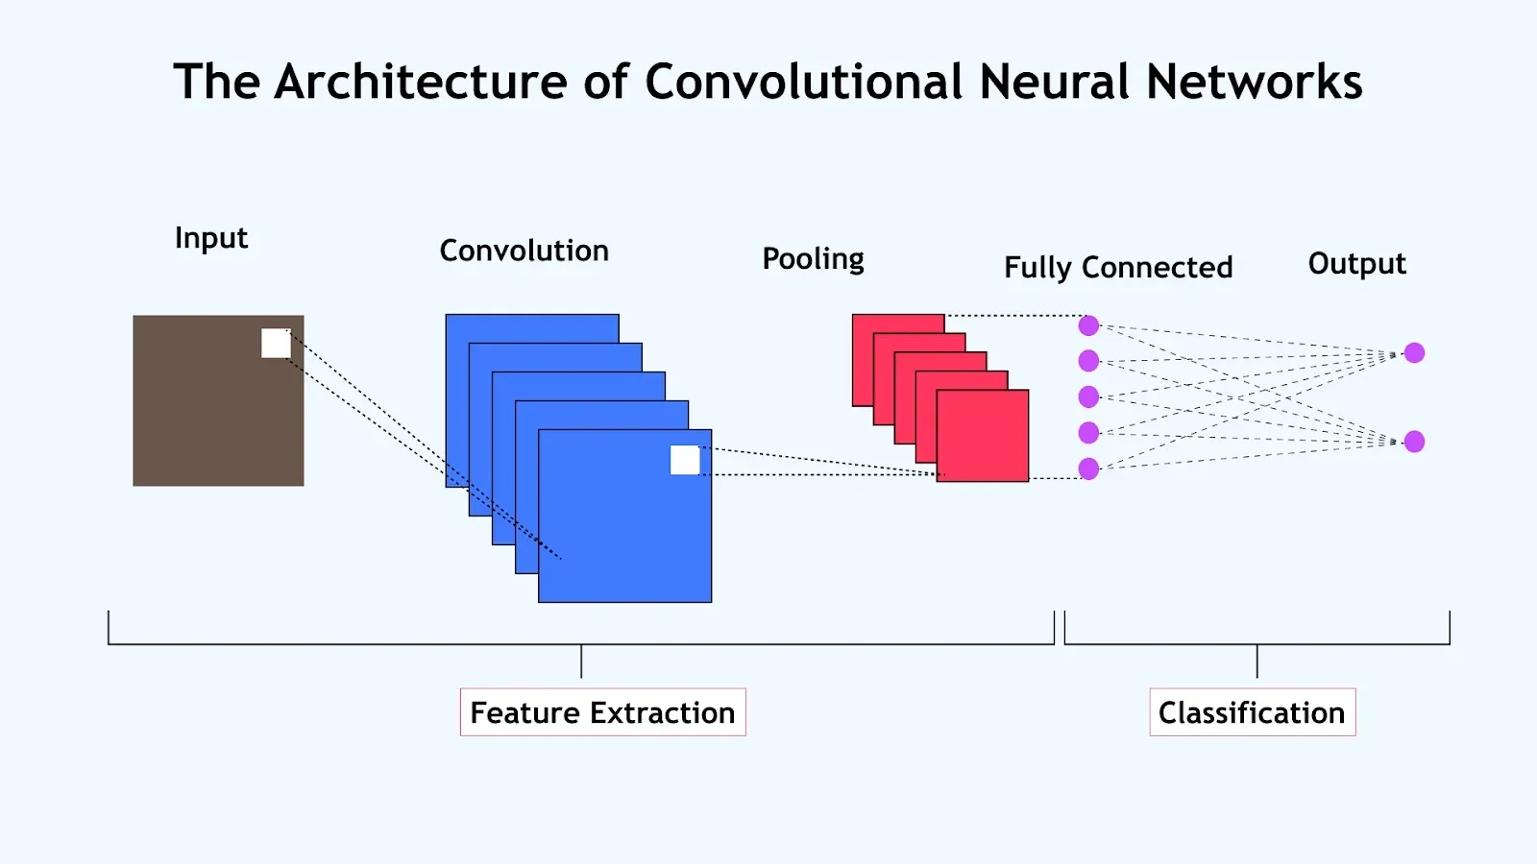
CONVOLUTIONAL NEURAL NETWORK
Though typically employed for image data, CNNs were adapted for our structured data by reshaping features into matrix format. This transformation allowed convolutional layers to effectively capture spatial dependencies and interactions among features. This approach leverages the CNN's ability to detect patterns in local regions of data, enhancing its capability to extract meaningful representations from structured datasets.
Conv1D Layers: 3 layers (64, 128, 256 filters) with ReLU activation
Pooling: MaxPooling after each convolution to reduce dimensionality
Dense Layers: 4 layers (512 → 256 → 128 → 64) with BatchNorm + Dropout
Output: Softmax layer for multi-class classification (Low, Medium, High)

Slide 19
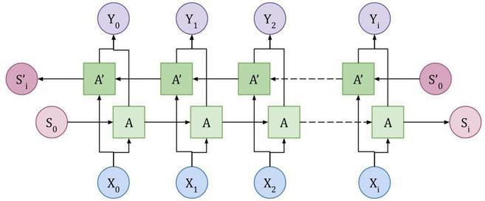
Bidirectional Long Short-Term Memory
The Bidirectional LSTM (BLSTM) model processes tabular input features in both forward and backward directions, allowing it to capture contextual dependencies across feature sequences. As shown in the architecture, input sequences X₀​ to X_{i​} pass through LSTM units (A) and their reverse counterparts (A′), with combined hidden states producing outputs Y_{0​} to Y_{i​}. Two stacked BLSTM layers followed by dense layers with dropout and batch normalization enhance learning and generalization. Although the data is tabular, reshaping it into sequence-like form allows the model to extract richer inter-feature relationships. The final softmax layer classifies buildings into multi-class damage grades.
BLSTM Architecture

Slide 20
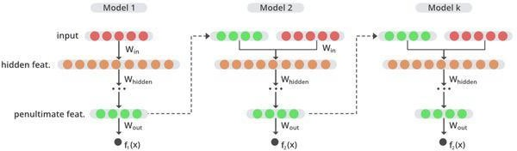
Gradient/Graph-Based Neural Network
GBNN combines tree-based models (like XGBoost) with neural networks by transforming decision paths (leaf indices) into high-dimensional learned embeddings, which are then passed to a deep neural network (DNN). This hybrid architecture captures both the structured logic of trees and the representation power of deep learning.
GBNN Architecture

Slide 21
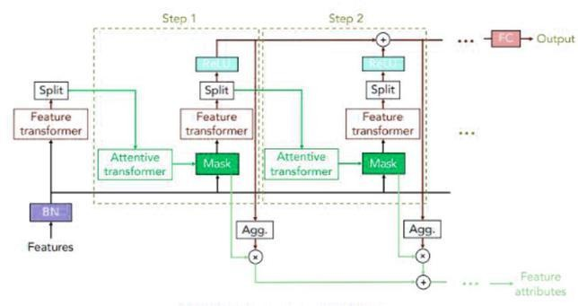
TabNet
TabNet is a deep learning architecture tailored for tabular data using sequential attention to select relevant features dynamically. It combines feature transformers and attentive transformers to learn complex patterns while maintaining interpretability. Sparse masks guide the model to focus on meaningful features at each decision step. Categorical features are one-hot encoded and numerical ones standardized for effective learning. The model uses an entmax mask type with three decision steps and is trained with Adam optimizer. Performance is evaluated using validation accuracy, confusion matrix, and classification metrics. TabNet effectively balances accuracy and feature-level interpretability in predicting building damages from earthquakes.
TabNet Architecture

Slide 22
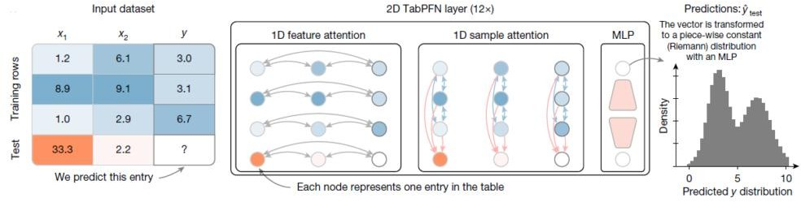
Tabular Prior-Data Fitted Network
TabPFN (Tabular Prior-Data Fitted Network) leverages prior distributions learned from synthetic tabular tasks to enable zero-shot inference on new datasets. It processes input tables using 1D feature and sample attention across multiple layers. Each node in the attention layers represents a single table entry, capturing interactions between features and samples. The network predicts the output distribution (e.g., regression target) for unseen data without needing retraining. Final predictions are produced by an MLP that transforms internal representations into a probability distribution. This enables fast, accurate tabular predictions without gradient-based training on the test data.
TabPFN Architecture

Slide 23
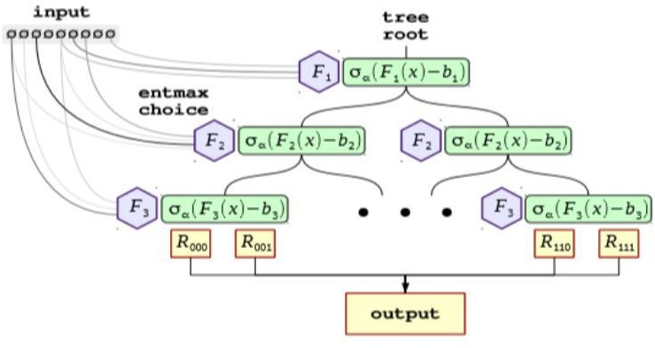
Neural Oblivious Decision Ensembles
A hybrid of deep learning and decision trees, offering interpretability and high performance on tabular data.
Learns hierarchical feature interactions efficiently, useful for multi-factor earthquake damage prediction.
Can handle both categorical and numerical data effectively
Neural Oblivious Decision Ensembles Architecture

Slide 24
Experimental Results and Analysis
Performance Measures
We evaluated models using,
Accuracy - The proportion of total correct predictions out of all predictions made.
Precision - The proportion of correctly predicted positives out of all predicted positives.
Recall - The proportion of correctly predicted positives out of all actual positives.
F1-score - The harmonic mean of precision and recall, balancing both metrics.
Confusion Matrix - A table showing true vs. predicted classifications for each class.

Slide 25
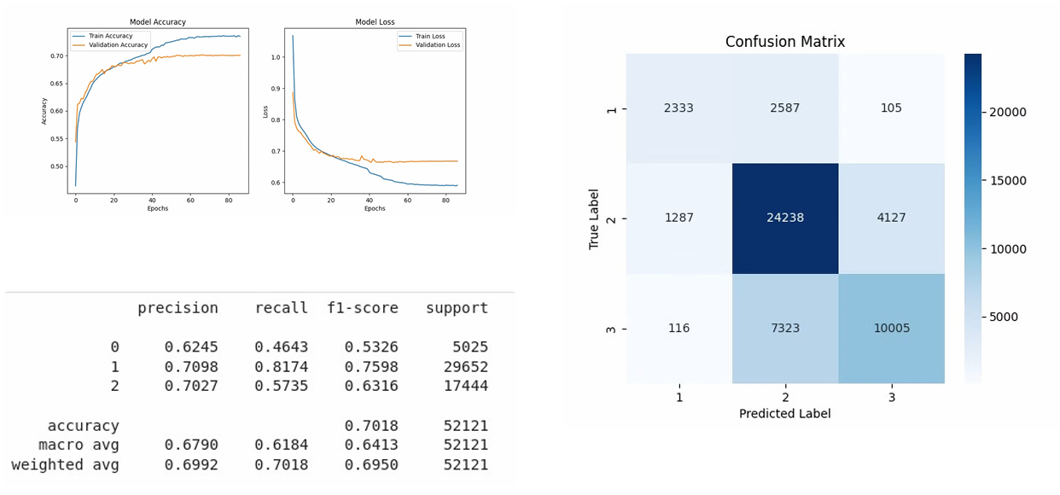
CNN

Slide 26
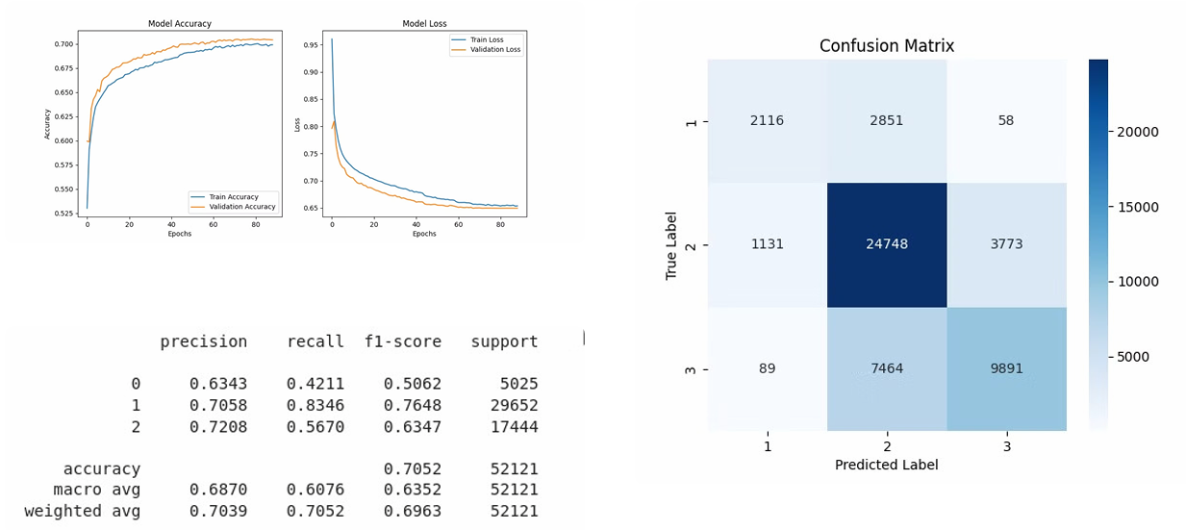
BLSTM

Slide 27
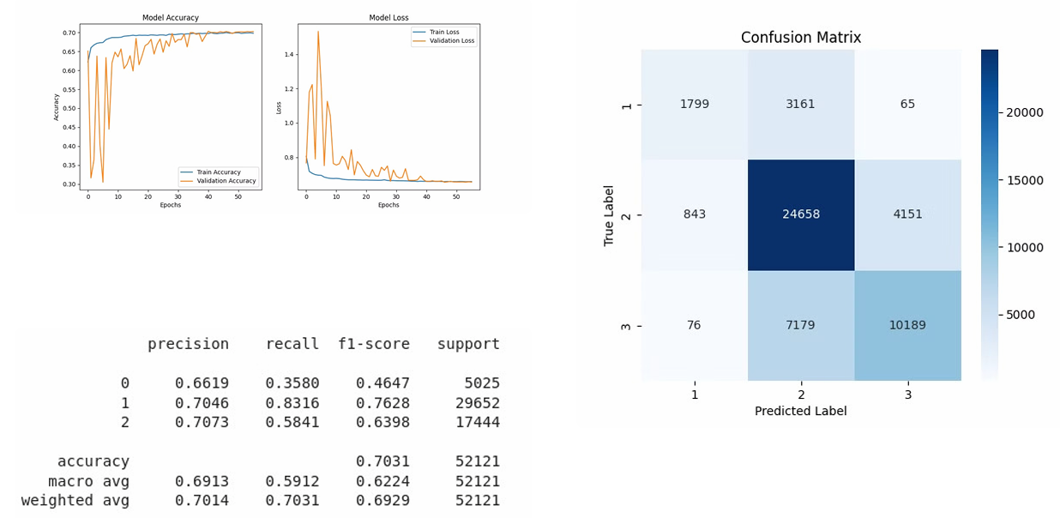
GBNN

Slide 28
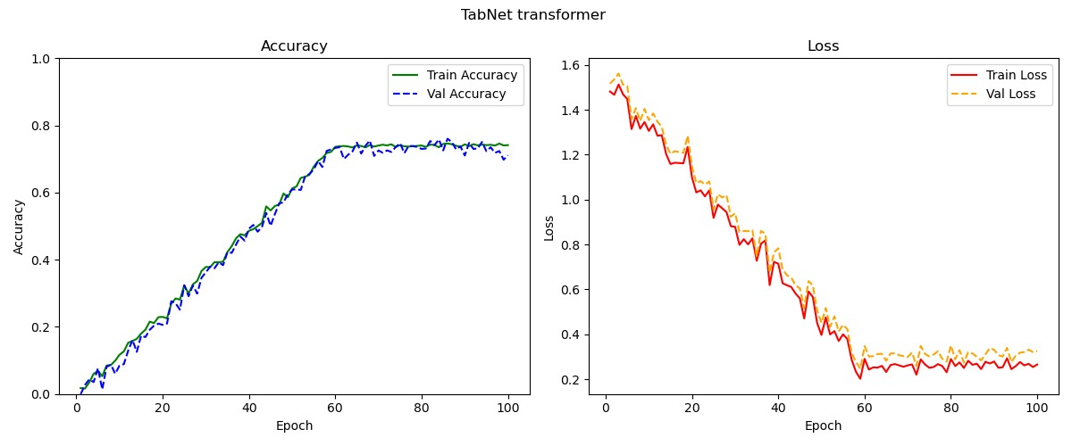
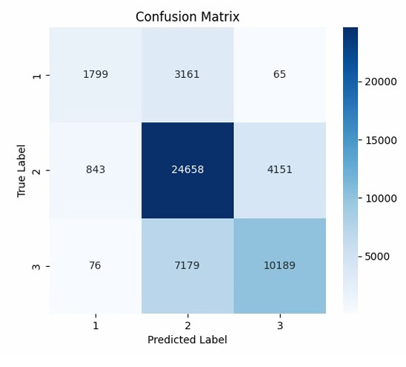

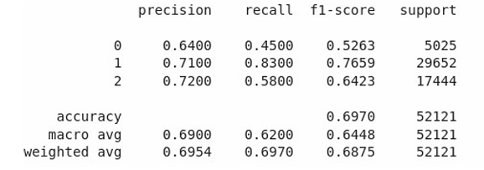
TabNet

Slide 29
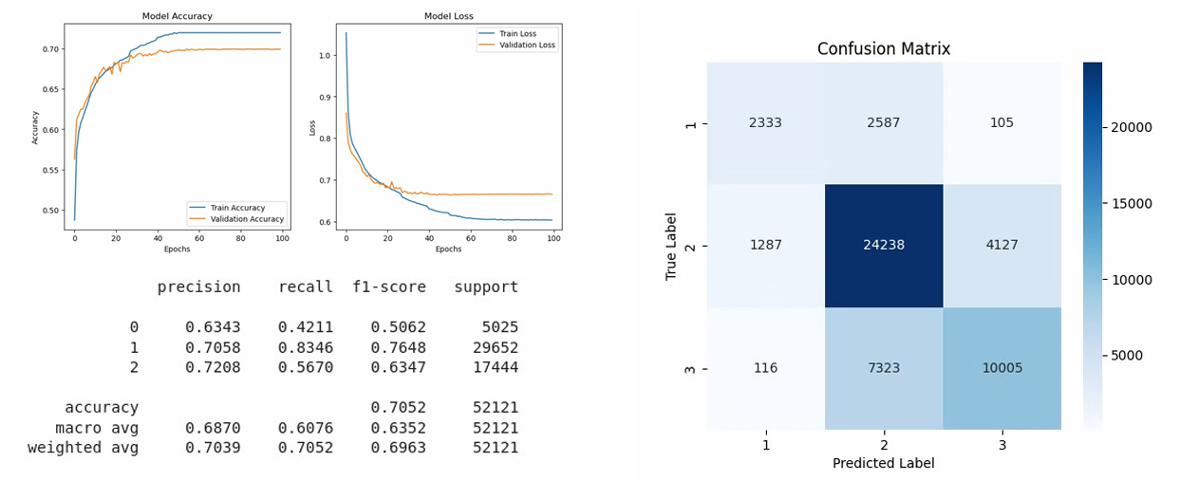
TabPFN

Slide 30
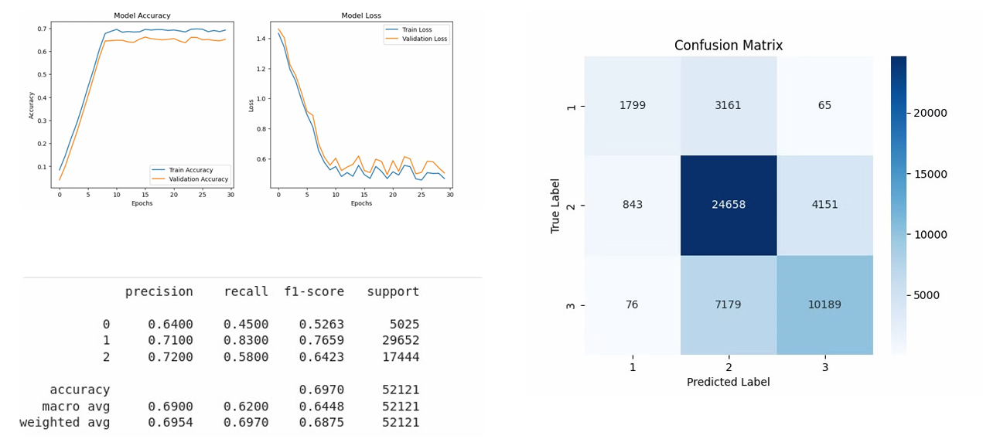
NODE

Slide 31
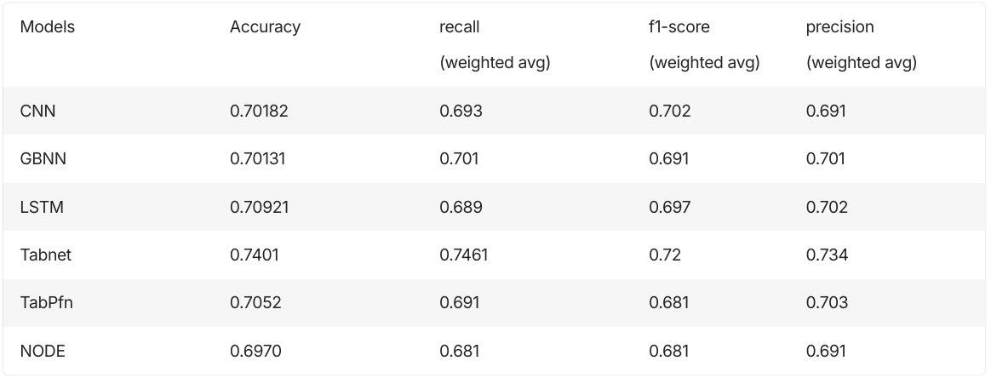
Comparative Analysis

Slide 32
Conclusion
From our experiments, transformer-based models (TabNet) significantly outperformed CNNs, GBNNs, and LSTMs for tabular data classification.TabNet achieved the highest accuracy of 74.1 %, proving to be the best choice for this problem.
Future work includes integrating ensemble methods, fine-tuning hyperparameters, and applying explainable AI techniques to better interpret the model¾s predictions

Slide 33
Thank You!

